Slide 1
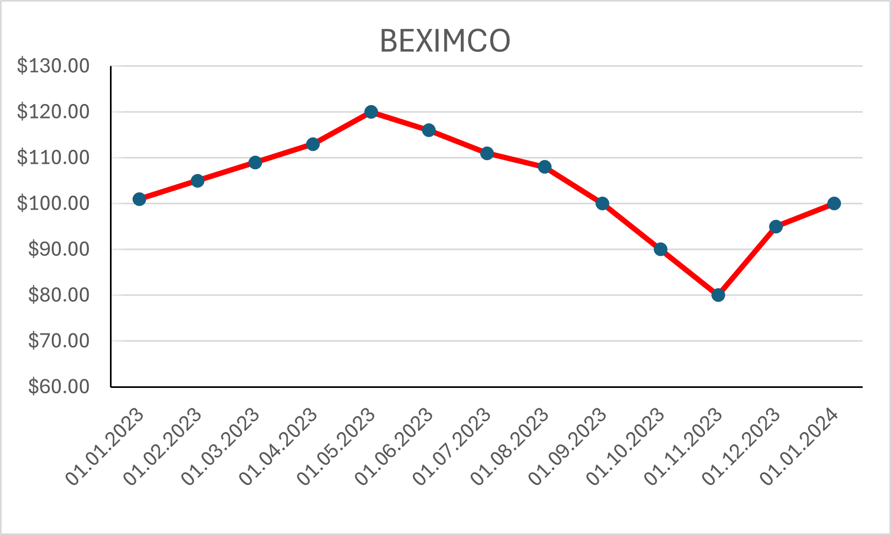
Predicting the Stock Price of Frontier Markets Using Modified Black-Scholes Option Pricing Model and Machine Learning
Presented by Group-7,
Md. Amanullah Shah – 2121737642
Joy Kumar Ghosh - 2211424642

Slide 2

Some Terms, used in Share Market
Stock/Share
Stock Price
Buy/Sell
Option
Call Option
Put Option
Strike Price
Expiration Time

Slide 3

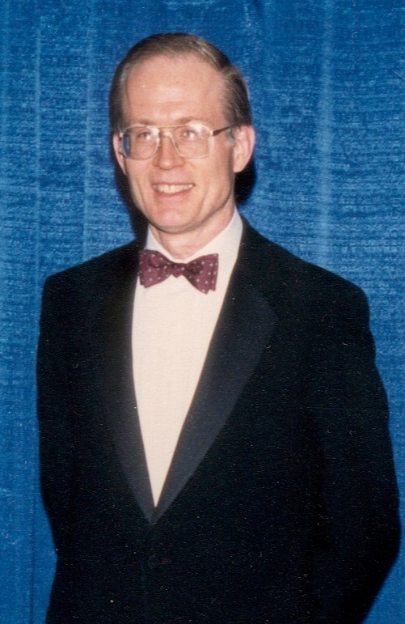

BSOPM
Developed in 1973
Developed by
Fischer Black
Myron Scholes
Robert Merton

Slide 4
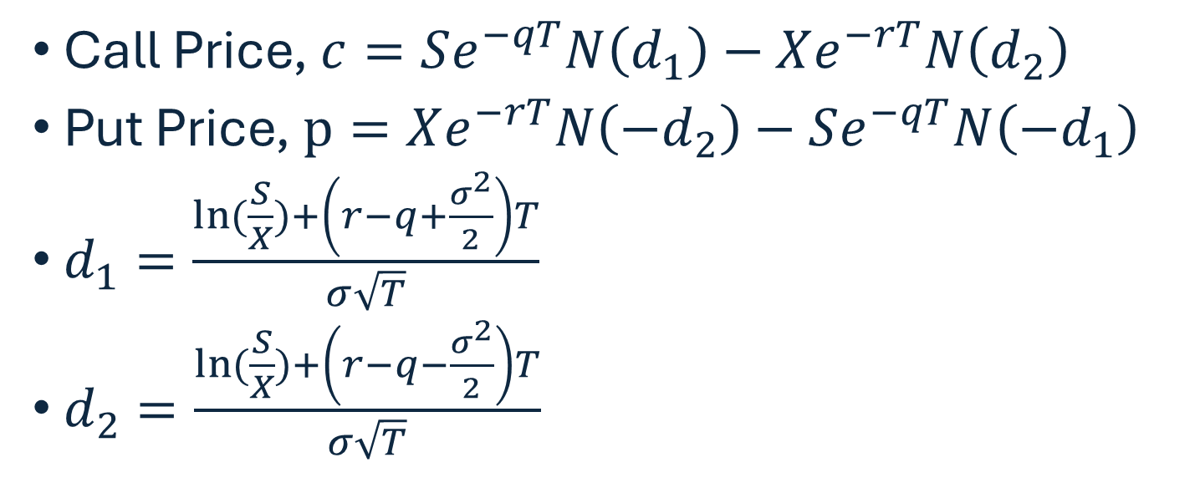
BSOPM Equation
Call Price, $c=Se^{−qT}N\left(d_{1}\right)−Xe^{−rT}N\left(d_{2}\right)$
Put Price, $p=Xe^{−rT}N\left({−d}_{2}\right)−Se^{−qT}N\left({−d}_{1}\right)$
$d_{1}=\frac{\ln{(\frac{S}{X})}+\left(r−q+\frac{σ^{2}}{2}\right)T}{σ\sqrt{T}}$
$d_{2}=\frac{\ln{(\frac{S}{X})}+\left(r−q−\frac{σ^{2}}{2}\right)T}{σ\sqrt{T}}$

Slide 5
Volatility: 20%
Stock Price: $100
Strike Price for Call : $110
Call Option Price : $10
Strike Price for Put : $90
Put Option Price : $10
Expiration Time : 1 Years
Risk Free Interest Rate : 3%
Dividend Yield : 2%

Slide 6
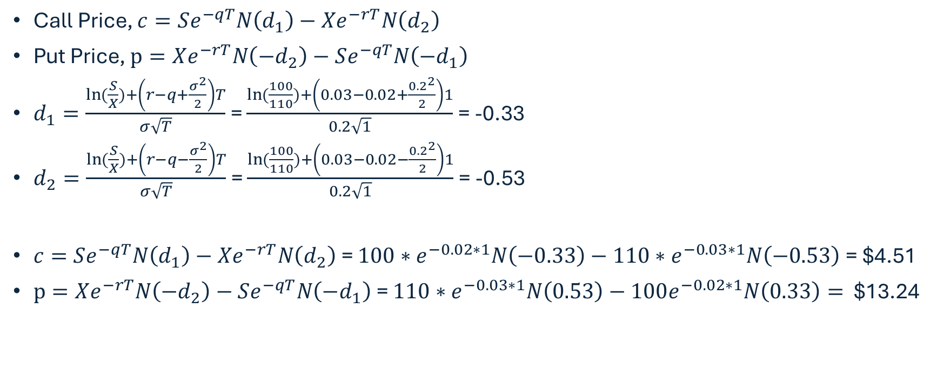
Let’s Calculate Call Price & Put Price using BSOPM
Call Price, $c=Se^{−qT}N\left(d_{1}\right)−Xe^{−rT}N\left(d_{2}\right)$
Put Price, $p=Xe^{−rT}N\left({−d}_{2}\right)−Se^{−qT}N\left({−d}_{1}\right)$
$d_{1}=\frac{\ln{(\frac{S}{X})}+\left(r−q+\frac{σ^{2}}{2}\right)T}{σ\sqrt{T}}$ = $\frac{\ln{(\frac{100}{110})}+\left(0.03−0.02+\frac{{0.2}^{2}}{2}\right)1}{0.2\sqrt{1}}$ = -0.33
$d_{2}=\frac{\ln{(\frac{S}{X})}+\left(r−q−\frac{σ^{2}}{2}\right)T}{σ\sqrt{T}}$ = $\frac{\ln{(\frac{100}{110})}+\left(0.03−0.02−\frac{{0.2}^{2}}{2}\right)1}{0.2\sqrt{1}}$ = -0.53
$c=Se^{−qT}N\left(d_{1}\right)−Xe^{−rT}N\left(d_{2}\right)$ = $100∗e^{−0.02∗1}N\left(−0.33\right)−110∗e^{−0.03∗1}N\left(−0.53\right)$ = $4.51
$p=Xe^{−rT}N\left({−d}_{2}\right)−Se^{−qT}N\left({−d}_{1}\right)$ = $110∗e^{−0.03∗1}N\left(0.53\right)−100e^{−0.02∗1}N\left(0.33\right)=$ $13.24

Slide 7

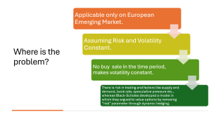


Let’s Compare The Theoretical Price and Option Price
$$≪$$
BSOPM Call Price: $4.51
Call Option Price: $10
$$≪$$
BSOPM Put Price: $13.24
Put Option Price: $10

Slide 8
Predicting the Stock Price of Frontier Markets Using Modified Black-Scholes Option Pricing Model and Machine Learning
Presented by Group-7,
Md. Amanullah Shah – 2121737642
Joy Kumar Ghosh - 2211424642

Slide 9

What is Share Market?

Slide 10
Some Terms, used in Share Market
Stock/Share
Stock Price
Buy/Sell
Option
Call Option
Put Option
Strike Price
Expiration Time

Slide 11
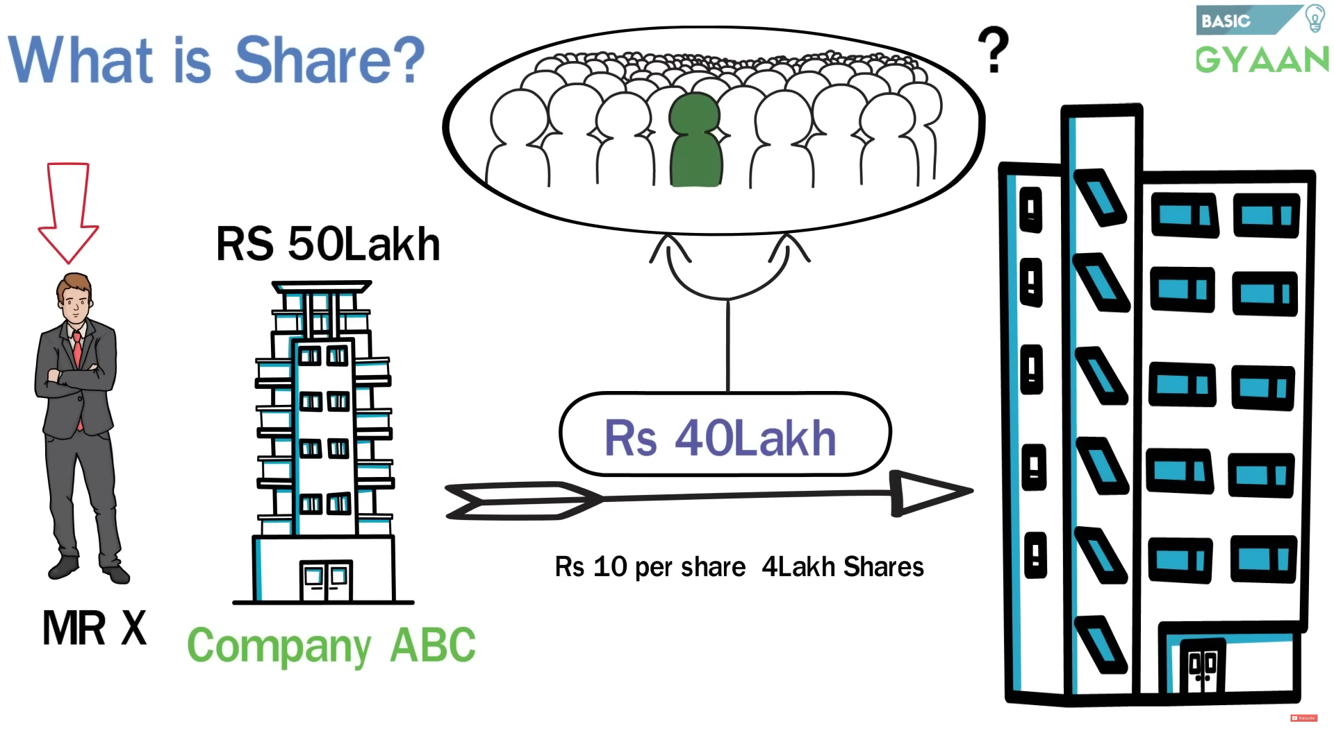

Slide 12
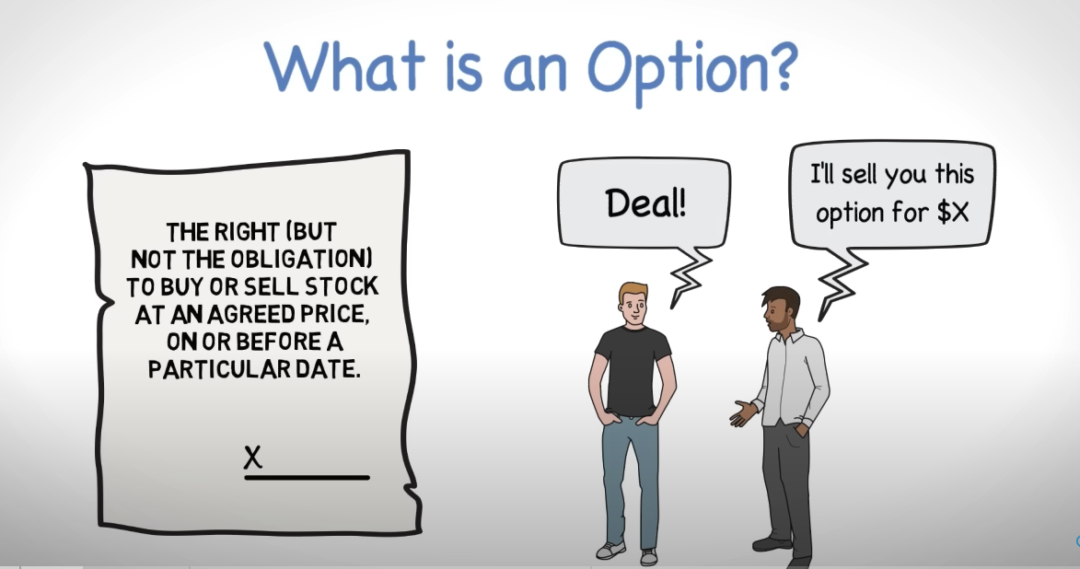

Slide 13
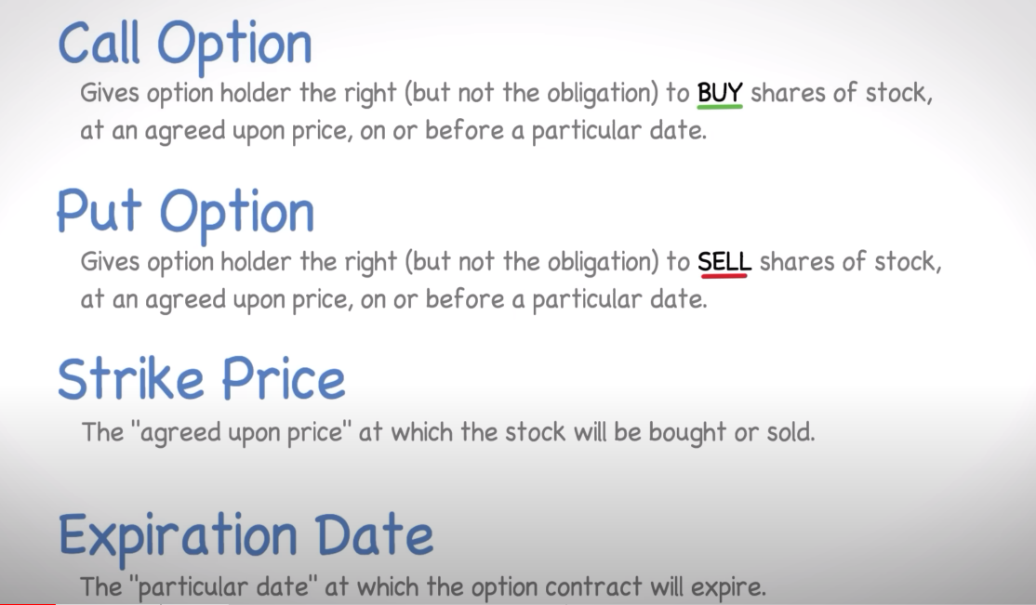

Slide 14
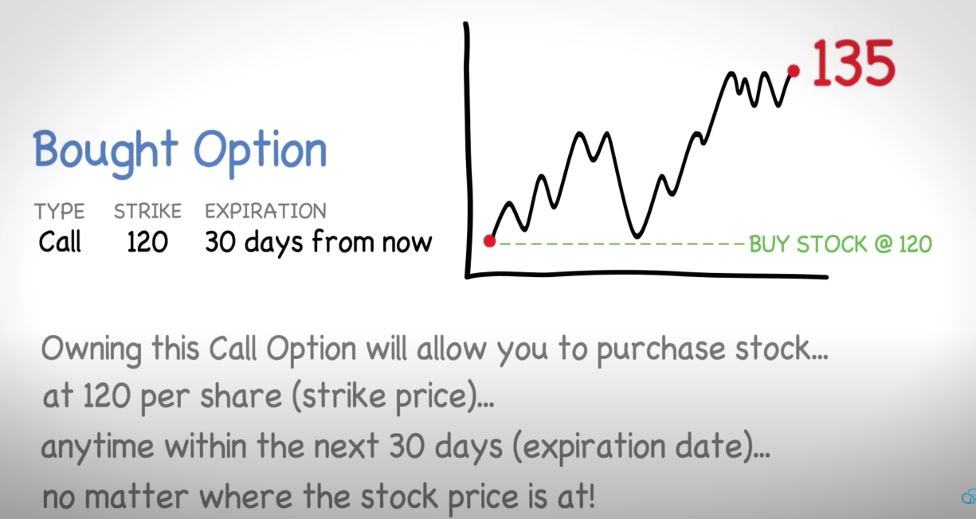

Slide 15
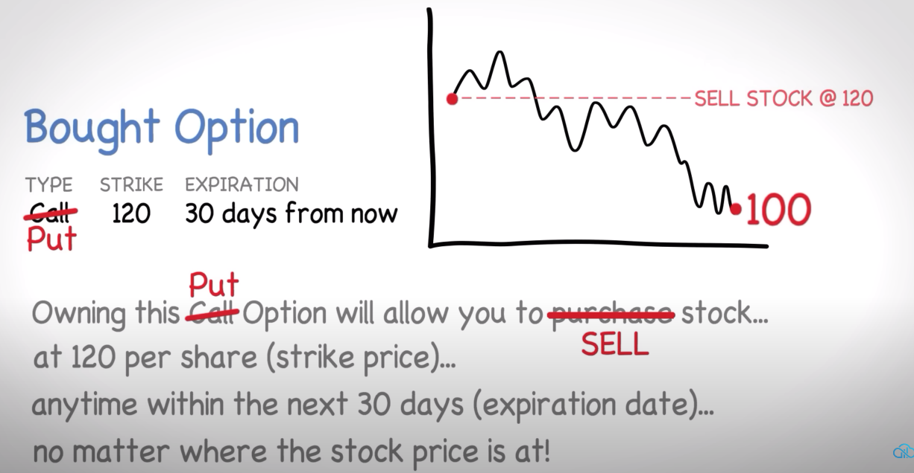

Slide 16



2%
3%

Slide 17
BSOPM
Developed in 1973
Developed by
Fischer Black
Myron Scholes
Robert Merton

Slide 18
BSOPM Equation
Call Price, $c=Se^{−qT}N\left(d_{1}\right)−Xe^{−rT}N\left(d_{2}\right)$
Put Price, $p=Xe^{−rT}N\left({−d}_{2}\right)−Se^{−qT}N\left({−d}_{1}\right)$
$d_{1}=\frac{\ln{(\frac{S}{X})}+\left(r−q+\frac{σ^{2}}{2}\right)T}{σ\sqrt{T}}$
$d_{2}=\frac{\ln{(\frac{S}{X})}+\left(r−q−\frac{σ^{2}}{2}\right)T}{σ\sqrt{T}}$

Slide 19

How BSOPM is beneficial to share holder?

Slide 20
Volatility: 20%
Stock Price: $100
Strike Price for Call : $110
Call Option Price : $10
Strike Price for Put : $90
Put Option Price : $10
Expiration Time : 1 Years
Risk Free Interest Rate : 3%
Dividend Yield : 2%

Slide 21
Let’s Calculate Call Price & Put Price using BSOPM
Call Price, $c=Se^{−qT}N\left(d_{1}\right)−Xe^{−rT}N\left(d_{2}\right)$
Put Price, $p=Xe^{−rT}N\left({−d}_{2}\right)−Se^{−qT}N\left({−d}_{1}\right)$
$d_{1}=\frac{\ln{(\frac{S}{X})}+\left(r−q+\frac{σ^{2}}{2}\right)T}{σ\sqrt{T}}$ = $\frac{\ln{(\frac{100}{110})}+\left(0.03−0.02+\frac{{0.2}^{2}}{2}\right)1}{0.2\sqrt{1}}$ = -0.33
$d_{2}=\frac{\ln{(\frac{S}{X})}+\left(r−q−\frac{σ^{2}}{2}\right)T}{σ\sqrt{T}}$ = $\frac{\ln{(\frac{100}{110})}+\left(0.03−0.02−\frac{{0.2}^{2}}{2}\right)1}{0.2\sqrt{1}}$ = -0.53
$c=Se^{−qT}N\left(d_{1}\right)−Xe^{−rT}N\left(d_{2}\right)$ = $100∗e^{−0.02∗1}N\left(−0.33\right)−110∗e^{−0.03∗1}N\left(−0.53\right)$ = $4.51
$p=Xe^{−rT}N\left({−d}_{2}\right)−Se^{−qT}N\left({−d}_{1}\right)$ = $110∗e^{−0.03∗1}N\left(0.53\right)−100e^{−0.02∗1}N\left(0.33\right)=$ $13.24

Slide 22

Let’s Compare The Theoretical Price and Option Price
$$≪$$
BSOPM Call Price: $4.51
Call Option Price: $10
$$≪$$
BSOPM Put Price: $13.24
Put Option Price: $10

Slide 23
Where is the problem?
Applicable only on European Emerging Market.
Assuming Risk and Volatility Constant.
No buy sale in the time period, makes volatility constant.
There is risk in trading and factors like supply and demand, bank rate, speculative pressure etc., whereas Black-Scholes developed a model in which they argued to value options by removing “risk” parameter through dynamic hedging.

Slide 24
Difference Between European and American Option
European Options:
European options can only be exercised at the expiration date.
This means that the holder of a European option can only exercise the option at the end of the option's life.
The Black-Scholes Options Pricing Model (BSOPM) is specifically designed to price European-style options, as it assumes that the option can only be exercised at expiration. This limitation makes the calculations simpler and more tractable.
American Options:
American options can be exercised at any time before the expiration date.
This flexibility allows the holder of an American option to exercise the option at any point during the option's life, up to and including the expiration date.
The ability to exercise early adds complexity to the option pricing model. Unlike European options, American options require a more sophisticated pricing model to account for the possibility of early exercise.

Slide 25
Where is the problem?
Applicable only on European Emerging Market.
Assuming Risk and Volatility Constant.
No buy sale in the time period, makes volatility constant.
There is risk in trading and factors like supply and demand, bank rate, speculative pressure etc., whereas Black-Scholes developed a model in which they argued to value options by removing “risk” parameter through dynamic hedging.

Slide 26
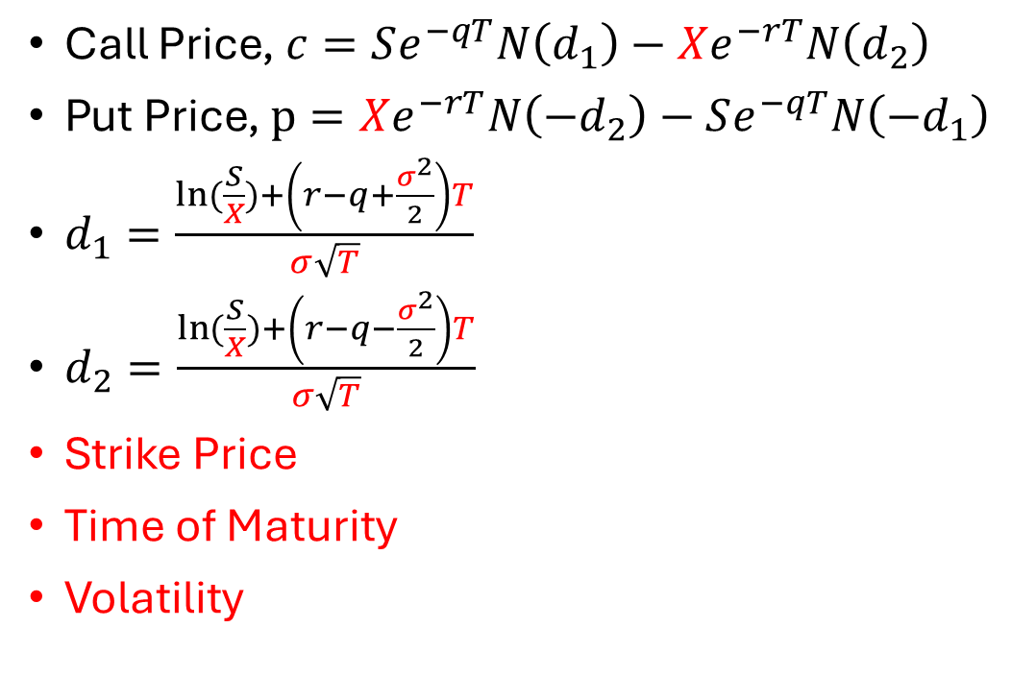
Where we need to modify to use it on Frontier Market?
Call Price, $c=Se^{−qT}N\left(d_{1}\right)−Xe^{−rT}N\left(d_{2}\right)$
Put Price, $p=Xe^{−rT}N\left({−d}_{2}\right)−Se^{−qT}N\left({−d}_{1}\right)$
$d_{1}=\frac{\ln{(\frac{S}{X})}+\left(r−q+\frac{σ^{2}}{2}\right)T}{σ\sqrt{T}}$
$d_{2}=\frac{\ln{(\frac{S}{X})}+\left(r−q−\frac{σ^{2}}{2}\right)T}{σ\sqrt{T}}$
Strike Price
Time of Maturity
Volatility

Slide 27
Another outcome of Volatility
Market Crash Directly Related to Volatility.

Slide 28
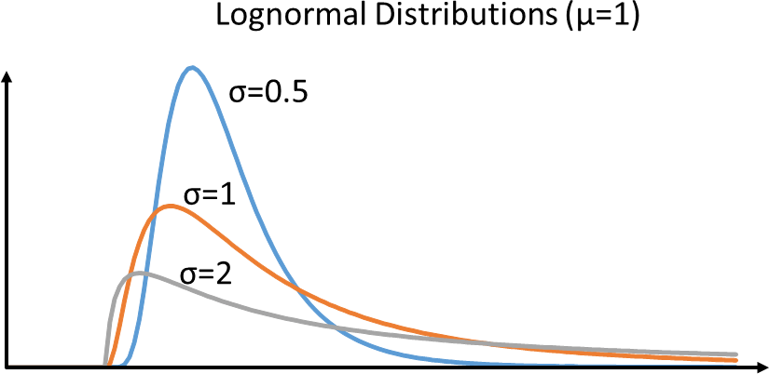
Stock Price Distribution is Lognormal
BSOPM

Slide 29
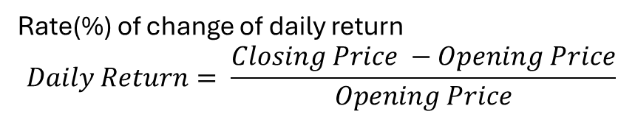
Stock Price ∝ Variance Rate
Rate(%) of change of daily return
$$Daily Return= \frac{Closing Price −Opening Price}{Opening Price}$$
BSOPM

Slide 30
Stock Price follows Brownian Motion
Constat Drift
Constant Volatility
BSOPM

Slide 31
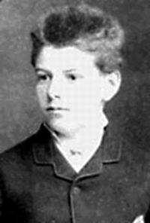
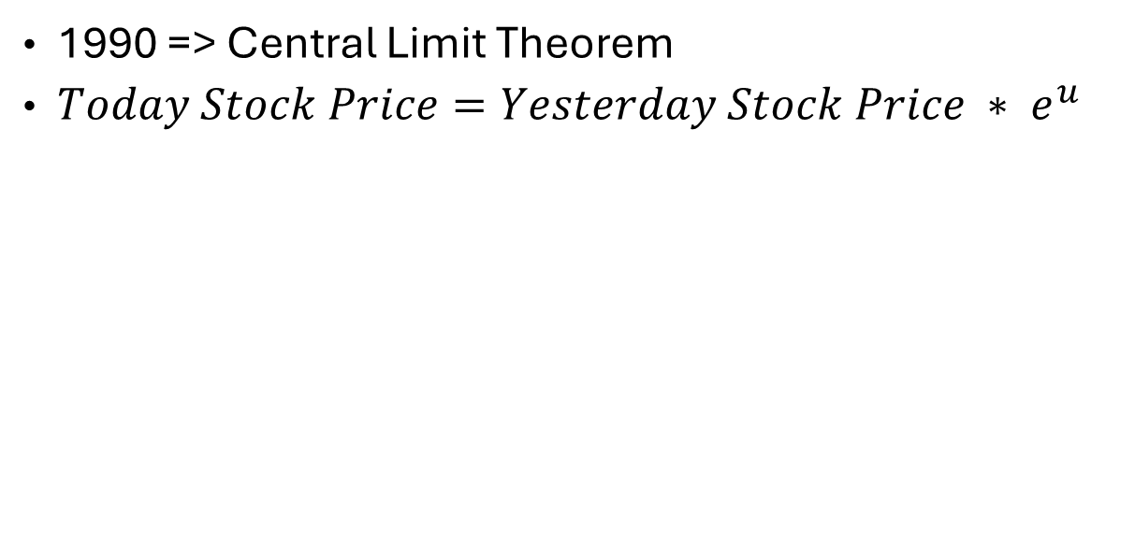
Louis Bachelier
1990 => Central Limit Theorem
$Today Stock Price=Yesterday Stock Price ∗ e^{u}$

Slide 32
$$Today Stock Price=Yesterday Stock Price ∗ e^{u}$$
Periodic Daily Return
=> Rate of increase or decrease

Slide 33
Louis Bachelier
Stochastic Process
Known as Brownian Motion

Slide 34
There is two part of an asset
Brownian Motion

Slide 35
Variance Rate of Return
& Interest Rate are constant
BSOPM

Slide 36
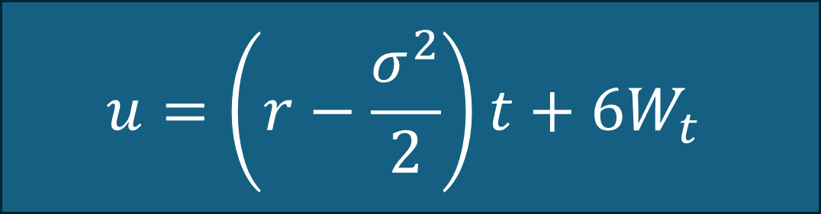
BSOPM
Brownian Motion
Wiener Process at time t
$$u=\left(r−\frac{σ^{2}}{2}\right)t+6W_{t}$$
Constant Drift
Random Stochastic Component

Slide 37


$$Today Stock Price=Yesterday Stock Price ∗ e^{u}$$
$$Future Stock Price=Current Stock Price ∗ e^{\left(r−\frac{σ^{2}}{2}\right)t+6W_{t}}$$
r
Volatility ↑↑
This Photo by Unknown Author is licensed under CC BY-NC

Slide 38
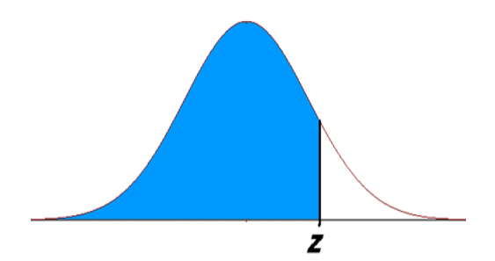

Periodic Daily Return(u)
Future Change of Stock Price
Brownian Motion
Mean, µ = Constant Drift = $\left(r−\frac{σ^{2}}{2}\right)$
Future Standard Deviation, $σ$= Past Standard Deviation, $σ$

Slide 39
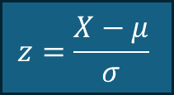
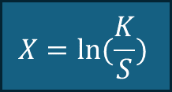
Future Change of Stock Price
Strike Price
$$X=\ln{(\frac{K}{S})}$$
Expected Rate of Growth
$$z=\frac{X−μ}{σ}$$
Stock Price
This Photo by Unknown Author is licensed under CC BY-NC
Bellow Strike Price || Above Strike Price

Slide 40
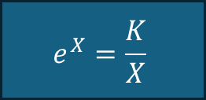
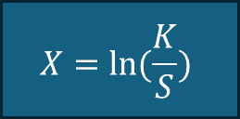
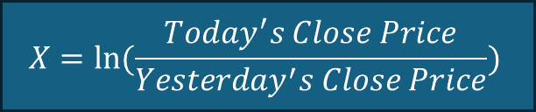
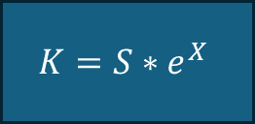
Let’s Find out “Strike Price”
Strike Price, Doesn’t exist in Frontier Market, Then K = ?
$$X=\ln{(\frac{K}{S})}$$
$$e^{X}=\frac{K}{X}$$
Daily Price Change in Frontier Market
$$K=S∗e^{X}$$
$$X=\ln{(\frac{Today^{′}s Close Price}{Yesterday^{′}s Close Price})}$$

Slide 41
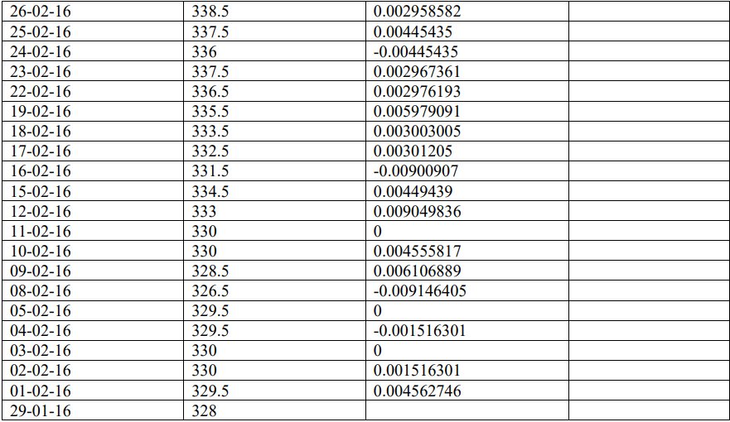

Slide 42
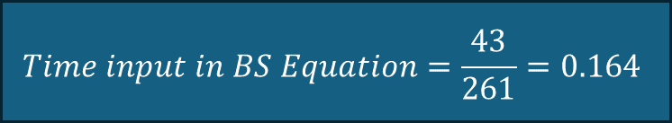
Let’s Find out “Time” Parameter
No Expiry Time!!
1st March 2015
1st January 2016
261 Days of Trade
43 Days of Trade
1st March 2016
Constant
$$Time input in BS Equation=\frac{43}{261}=0.164$$

Slide 43
Let’s Find Out “Volatility”
Volatility
Historical Volatility
Implied Volatility

Slide 44
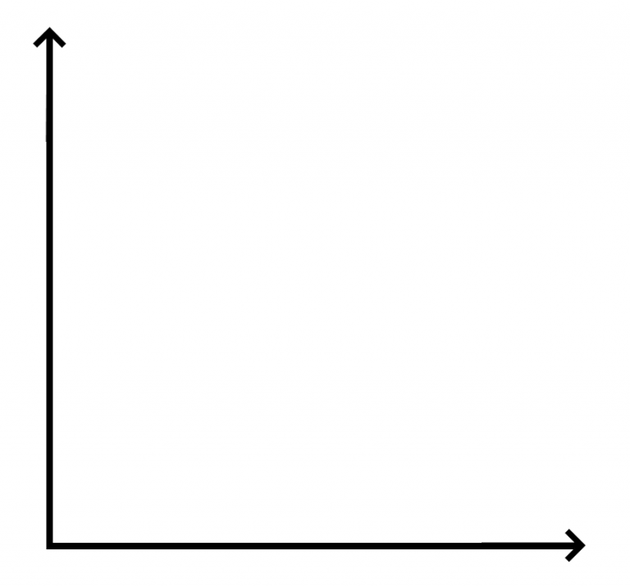
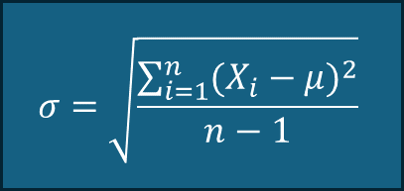
Volatility!!
$$σ=\sqrt{\frac{\sum_{i=1}^{n}{{(X_{i}−μ)}^{2}}}{n−1}}$$
MATLAB Simulink
𝜎 = 𝑠𝑡𝑎𝑛𝑑𝑎𝑟𝑑 𝑑𝑒𝑣𝑖𝑎𝑡𝑖𝑜𝑛
𝑋 = 𝑑𝑎𝑖𝑙𝑦 𝑝𝑟𝑖𝑐𝑒 𝑐ℎ𝑎𝑛𝑔𝑒 𝑜𝑓 𝑡ℎ𝑒 𝑠𝑡𝑜𝑐𝑘𝑠
𝜇 = 𝑚𝑒𝑎𝑛 𝑜𝑟 𝑎𝑣𝑒𝑟𝑎𝑔𝑒 𝑜𝑓 𝑡ℎ𝑒 𝑠𝑡𝑜𝑐𝑘𝑠
𝑛 = 𝑛𝑢𝑚𝑏𝑒𝑟 𝑜𝑓 𝑣𝑎𝑙𝑢𝑒𝑠 𝑖𝑛 𝑡ℎ𝑒 𝑑𝑎𝑡𝑎𝑠𝑒t
Close Price of a Month
Dates

Slide 45
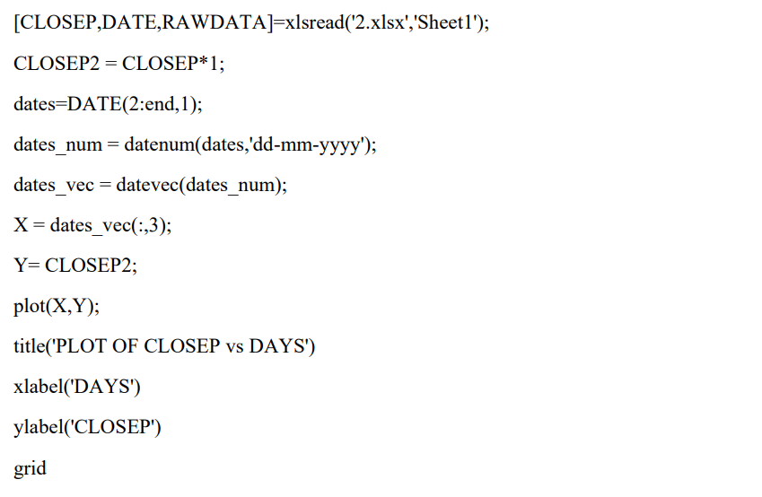

Slide 46
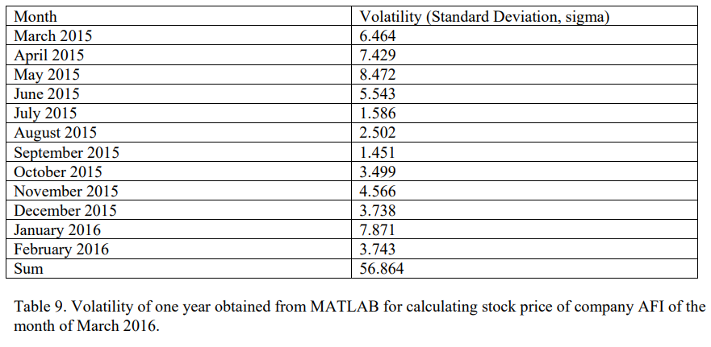

Slide 47
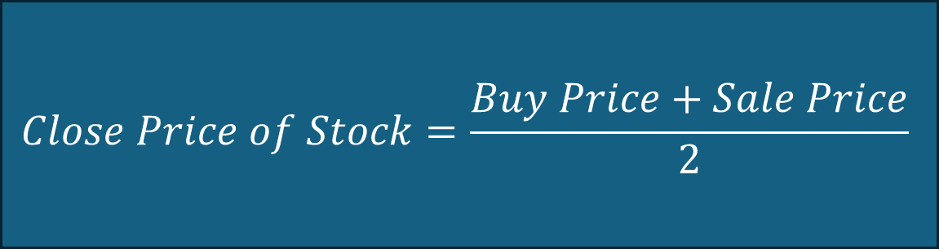
Call Option, C
Buy Price
Put Option, P
Sale Price
$$Close Price of Stock=\frac{Buy Price+Sale Price}{2}$$

Slide 48
Dividend
Stock Price
Predicted Close Price

Slide 49
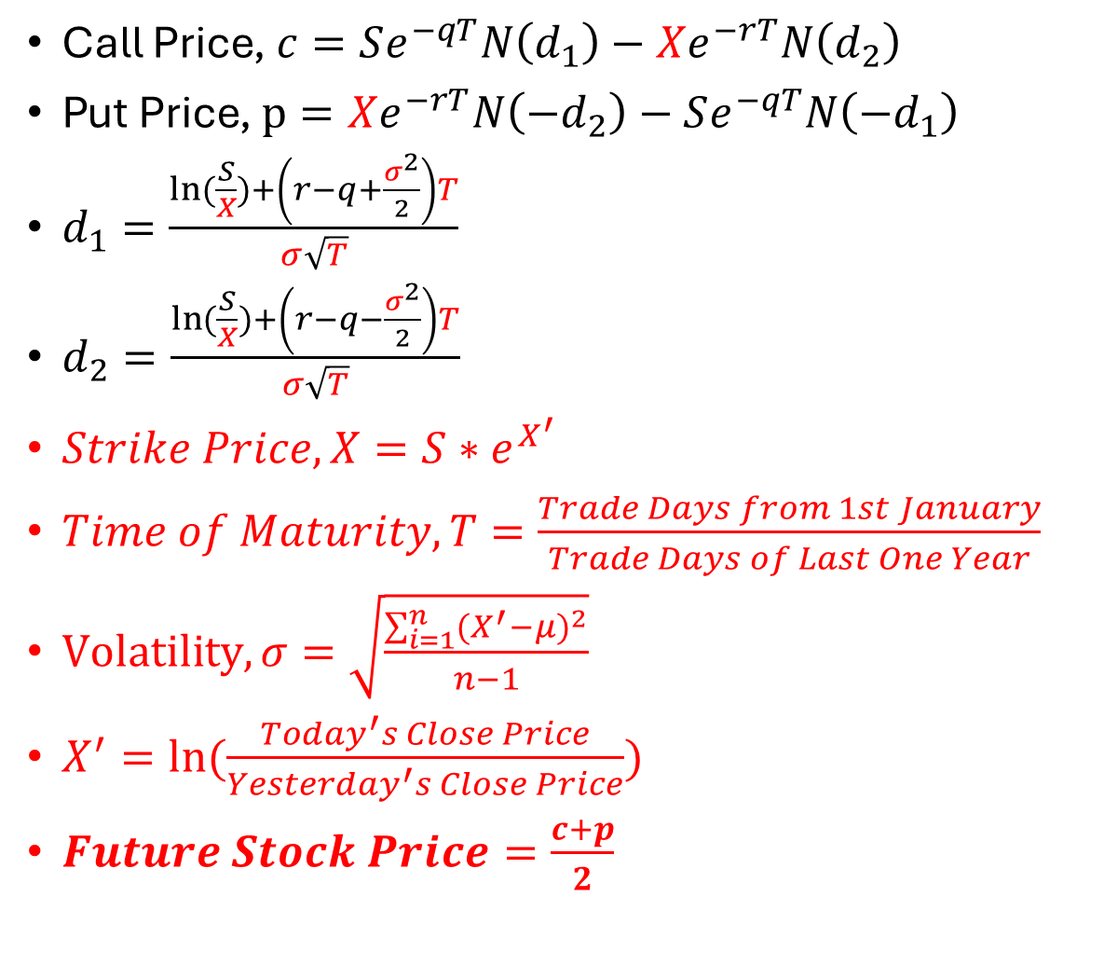
Final Modification
Call Price, $c=Se^{−qT}N\left(d_{1}\right)−Xe^{−rT}N\left(d_{2}\right)$
Put Price, $p=Xe^{−rT}N\left({−d}_{2}\right)−Se^{−qT}N\left({−d}_{1}\right)$
$d_{1}=\frac{\ln{(\frac{S}{X})}+\left(r−q+\frac{σ^{2}}{2}\right)T}{σ\sqrt{T}}$
$d_{2}=\frac{\ln{(\frac{S}{X})}+\left(r−q−\frac{σ^{2}}{2}\right)T}{σ\sqrt{T}}$
$Strike Price, X=S∗e^{X^{′}}$
$Time of Maturity,T=\frac{Trade Days from 1st January}{Trade Days of Last One Year}$
$Volatility, σ=\sqrt{\frac{\sum_{i=1}^{n}{{(X^{′}−μ)}^{2}}}{n−1}}$
$X^{′}=\ln{(\frac{Today^{′}s Close Price}{Yesterday^{′}s Close Price})}$
$Future Stock Price=\frac{c+p}{2}$

Slide 50
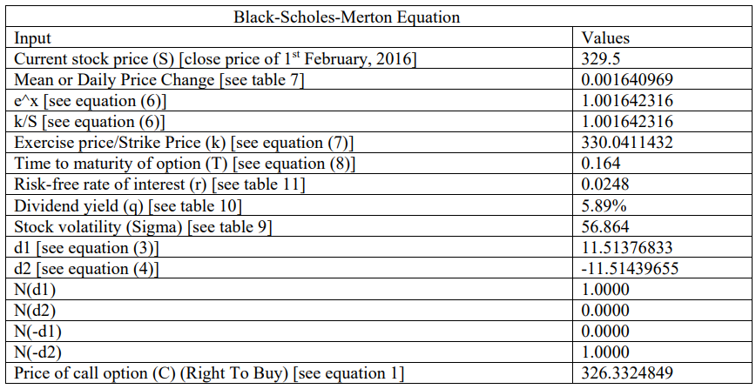
Thomson Reuter

Slide 51
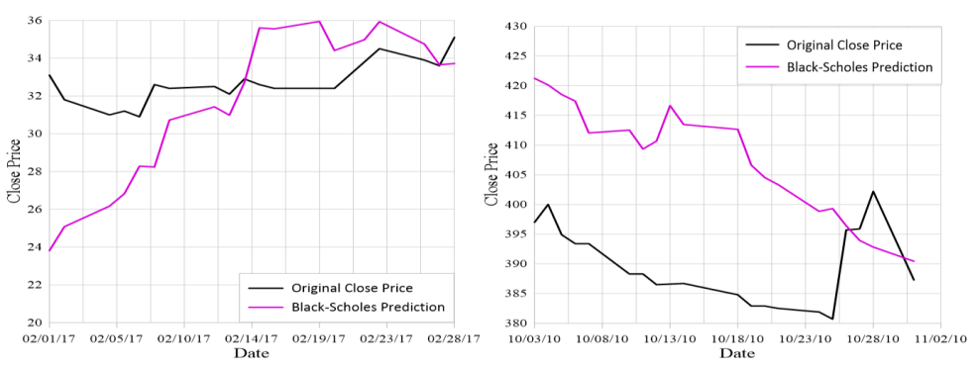
BEXIMCO
ACI

Slide 52
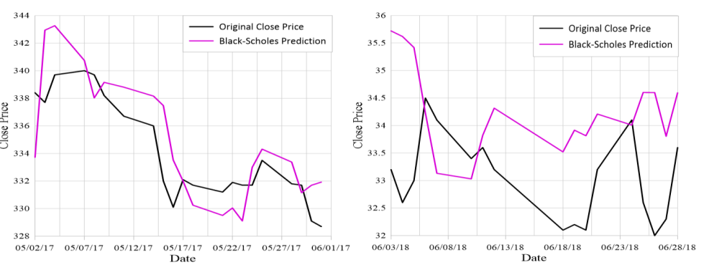
GP
GP

Slide 53
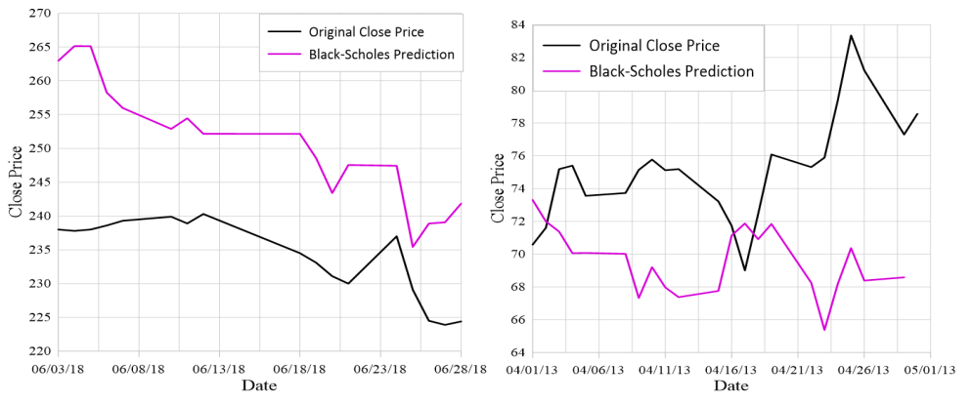
Olympic
Olympic

Slide 54
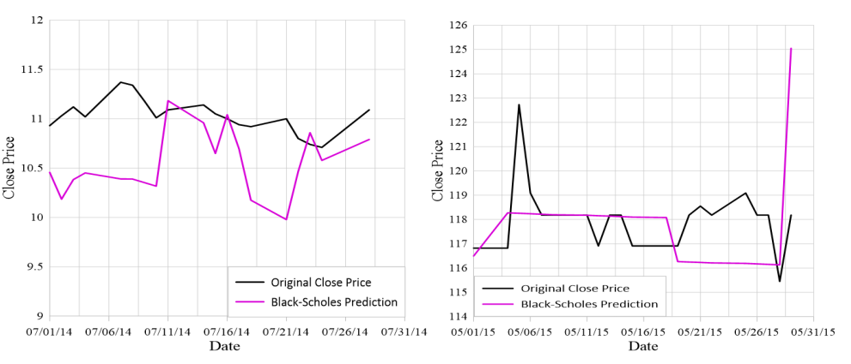
BYCO
CTHR.N0000

Slide 55
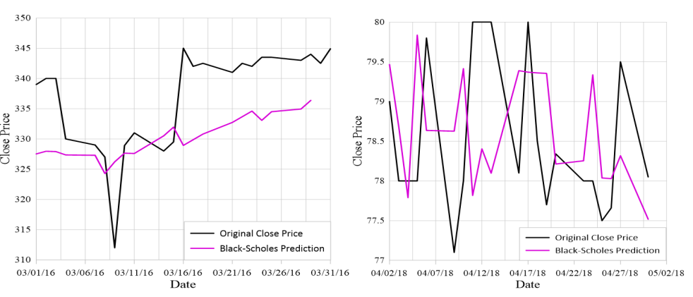
AFI
ATL

Slide 56

Machine Learning Approach

Slide 57
Machine Learning
Representation
Generalization
Generalization
Supervised
Unsupervised

Slide 58
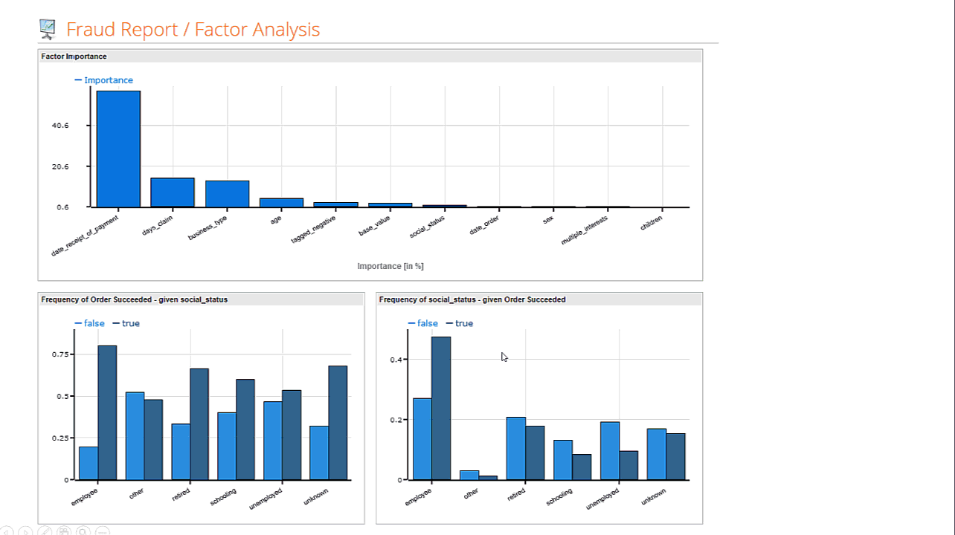
Rapid Miner
Automated In-database Processing
Run data prep and ETL inside databases to keep your data optimized for advanced analytics
Query and retrieve data without writing complex SQL

Slide 59
Rapid Miner
Data Visualization & Exploration
Understand patterns, trends, and distributions with scatter plots, histograms, line charts, parallel coordinates, box plots, and more
Quickly find and fix common data quality problems including missing values and outliers
Explore data using robust statistical overviews and over 30 interactive visualizations

Slide 60
Rapid Miner
Visual & Automated Machine Learning
Quickly create impactful machine learning models without writing code
Choose from hundreds of supervised and unsupervised machine learning algorithms
Implement basic and advanced ML techniques including regression, clustering, time-series, text analytics, and deep learning
Use both automated and manual feature engineering to optimize model accuracy

Slide 61
Rapid Miner
Model Validation
Eliminate overfitting through a unique approach
Cross validation

Slide 62
Rapidminer
Decision Tree
Neural Net
Ensemble Method

Slide 63
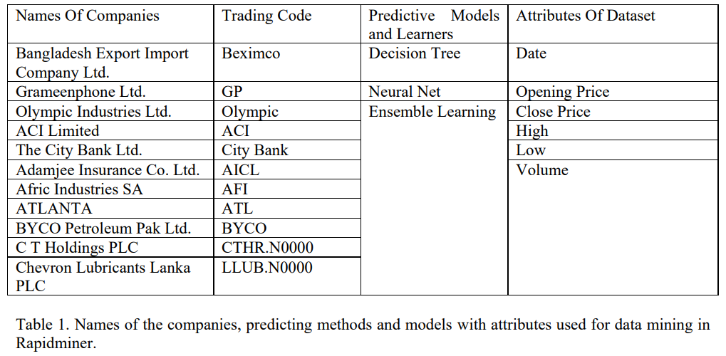
Dhaka Stock Exchange
Pakistan Stock Exchange
Casablanca Stock Exchange
Colombo Stock Exchange

Slide 64

Decision Tree
Decision tree can be used for both Classification and Regression problems.
RapidMiner automatically generates the tree model to predict the close price of the companies we have experimented using BSOPM.
We gave the historical price data as input to train our model along with the close price.
For testing we just used only One months of data.
We have tuned our parameter to get the best accuracy from the model.
We have tuned the maximum depth of the tree to 25 from 20 and minimal gain tuned to 0.15.

Slide 65
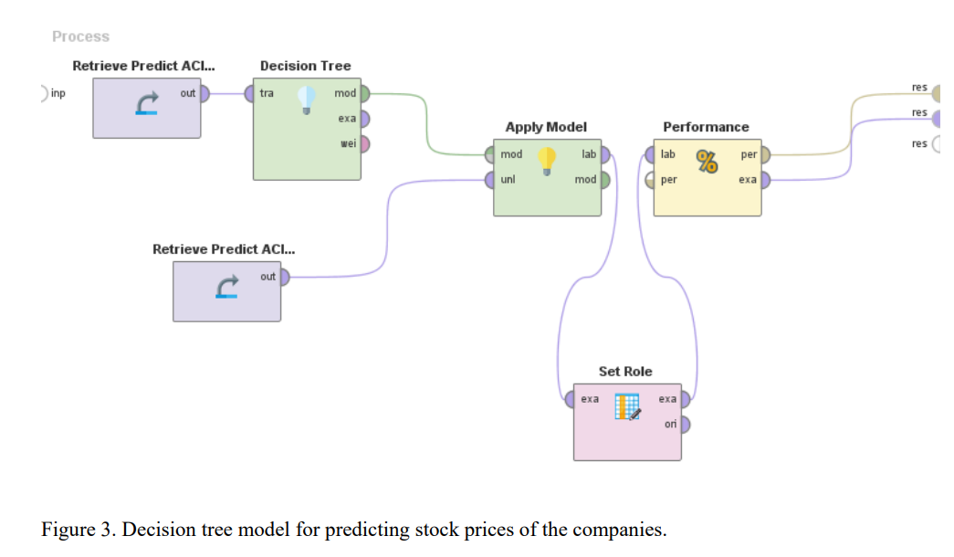
Generated by Rapidminer

Slide 66

Neural Net
Neural net is modelled on the human brain and nervous system because it is an interconnected network, which works through various nodes called neurons.
Rapidminer provides neural network model

Slide 67
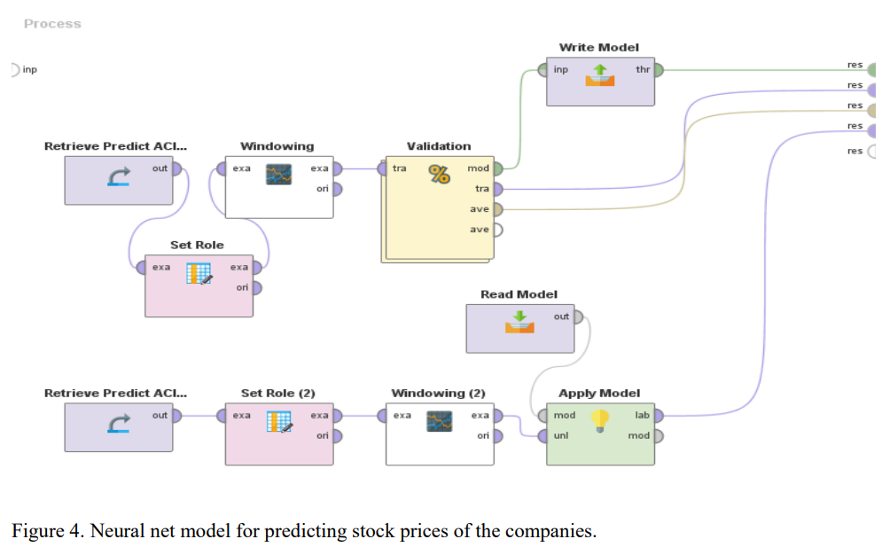
Generated by Rapidminer

Slide 68

Ensemble Method
Ensemble learning is a machine learning technique, where multiple machine learning algorithms or learners strategically generated and combined together in order to solve one particular computational intelligence problem.
Ensemble learning improves the performance of a model, or it reduces the likelihood of an unfortunate selection of a bad model for prediction. So, ensemble learning method ensures the best prediction analysis and optimum output.

Slide 69
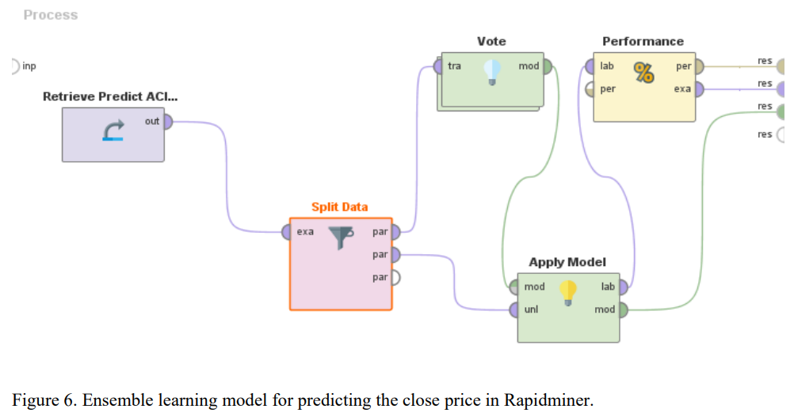
Generated by Rapidminer

Slide 70
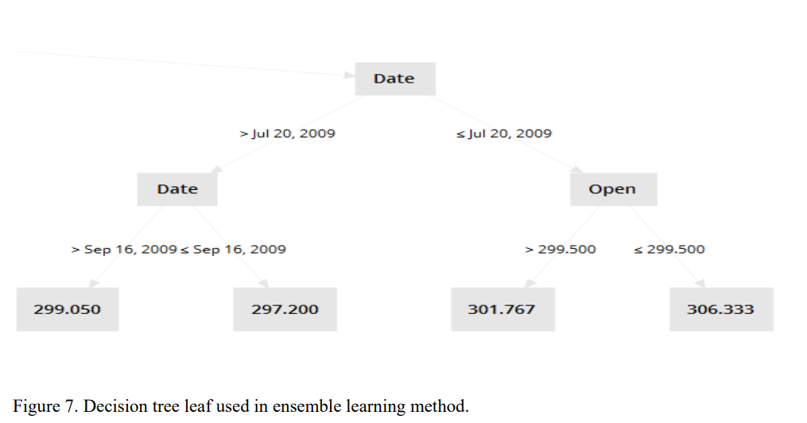
Generated by Rapidminer

Slide 71

Thank You

